Slide 1

Stay Pro Rewards
Ritu Bansal
11/21/2025
Notes:
Notes

Slide 2


Executive Summary: Stay Pro Rewards
Purpose & Objective
Strengthen brand loyalty & increase repeat engagement
Create a unified company initiative that enhances the brand experience
Program Overview
Points based program with bespoke/tailored benefits based on spend
Benefits designed to motivate ongoing customer interaction
Targeted to small business owners who can utilize benefits for further savings
Rewards include discounts and personalized offers
What this means for our teams
A new tool to deepen customer relationships
Clear opportunities to deliver differentiated service
Benefits to Stay N Sleep
Higher retention and stronger purchase patterns
Competitive advantage through a more engaging customer experience
Reduction in customer acquisition costs
Implementation & Timeline
Phase 1: Initial design of program with architectural solution
Phase 2: Vendor contract finalization, dashboard & notification development and soft launch
Phase 3: Full launch
Phase 4: Survey and impact review
Link to Product Requirements Document
Notes:
Notes

Slide 3
Who We Serve
Notes:
Notes

Slide 4

 | Alice Brooks Community-Centered, Ambitious, Budget-Conscious, Creative ABOUT Alice owns a neighborhood coffee shop and a small-batch roasting business. She travels regularly to source beans, attend coffee expos, collaborate with local vendors, and host pop-up coffee tastings in new cities. Because her business blends retail, hospitality, and community building, she often needs flexible spaces where she can stay, work, and host small gatherings — all in one booking. Traditional hotels and meeting spaces feel stiff, overpriced, and not aligned with her brand vibe. Stay N’ Sleep gives her warm, functional spaces she can customize for tastings, small workshops, or mini team sessions.
“I need spaces where I can brew, connect, and rest — all in one place, without juggling multiple bookings or breaking the budget.” DEMOGRAPHIC DATA Age: 34 Work: Coffee Shop Owner + Roaster Civil Status: Married Location: Portland, WA Character: Creator & Community Builder FAVORITE BRANDS Blue Bottle, Fellow, Square, Shopify, Patagonia, Lyft | GOALS Find flexible accommodations for business travel and hosting tastings/workshops Keep expenses predictable and within budget Earn rewards that support her small business (groceries, ride credits, event supplies) Build deeper relationships with suppliers and local communities | NEEDS Multi-purpose spaces with open layout, good lighting, and kitchen access Fast and easy booking Rewards relevant to running a small business Transparent pricing with no surprises
 | PAIN POINTS Hotels lack functional areas for tastings or meetings Renting event spaces is expensive and inconvenient Hard to find stays that align with her creative, community-driven brand Loyalty programs rarely offer practical, business-friendly rewards | PREFERRED CHANNELS Referral/Word of Mouth 50% Email/App Notifications 30% Social Media/Professional Networks 10% Targeted Partnerships 10%
Personas

Slide 5

 | Emma Efficient, Time-Conscious, Organized, Detail-Oriented ABOUT Alice is a corporate professional who travels frequently for work, especially during Q3 and Q4 when business events peak. Her trips often include client meetings, networking, and team gatherings. She looks for flexible, reliable accommodations that support her professional needs and personal comfort. Alice values efficiency, convenience, time-saving solutions, and work-friendly amenities while on trip.
“Success is the best revenge.” DEMOGRAPHIC DATA Age: 35 Work: Marketing Manager Civil Status: Married Location: Chicago, IL Character: Go-Getter FAVORITE BRANDS Starbucks Sephora | GOALS Book reliable, work-friendly stays quickly. Reduce hassle during busy travel periods. Stay productive while on the road. Engage with loyalty perks that save time. | NEEDS Fast and predictable booking, check-in, and check-out. Workspace-friendly accommodations (desk, Wi-Fi, quiet rooms). Automated rewards or easy redemption. Smart, personalized recommendations for perks or packages
 | PAIN POINTS Fewer amenities than hotels – Limited services like room service, gyms, or concierge. Transportation challenges – Need easy access to airports, meetings, and local venues. Inconsistent accommodation quality or workspace setup. Local area risks – Unfamiliar neighborhoods may feel less safe or reliable. Loyalty programs that are complicated or time-consuming. | PREFERRED CHANNELS Email / Push Notifications: 30% Corporate Partnerships / Travel Admin: 50% Social Sharing / Referrals: 20%

Slide 6
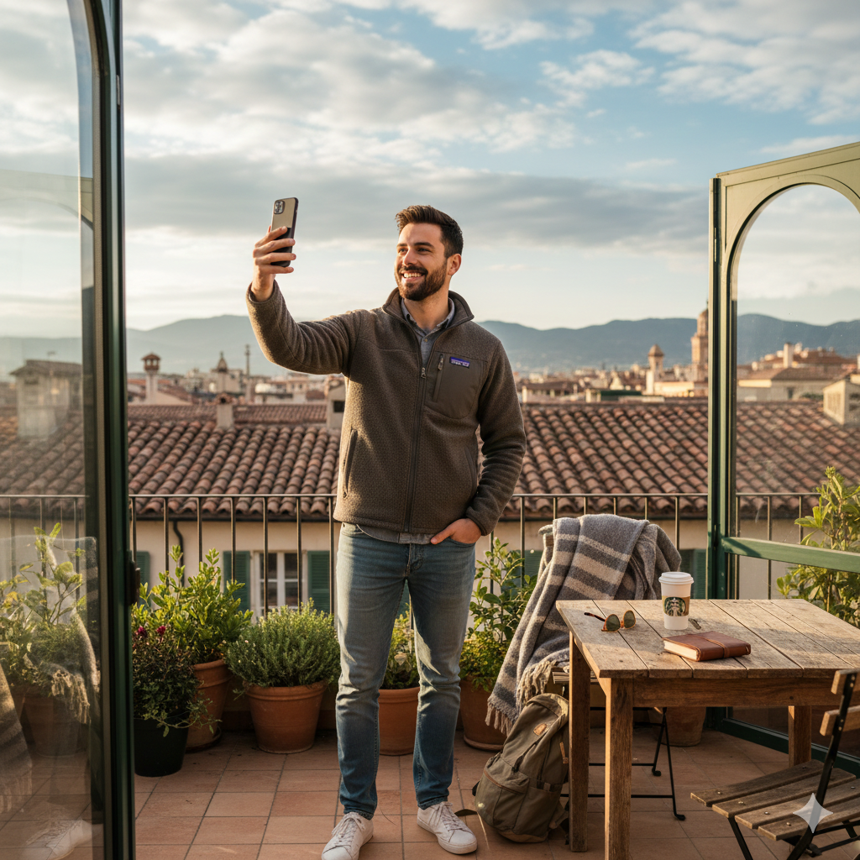
 | Ethan Miller Spontaneous, Social, Experience-Seeker, Relaxed ABOUT Ethan is a leisure traveler who enjoys exploring new cities, local culture, and unique experiences. He takes trips mostly for vacations, weekends, and seasonal holidays. He looks for comfortable, convenient, and Instagram-worthy accommodations that offer easy access to attractions, restaurants, and social activities.
“I travel to make memories and discover new places — I want my stay to feel effortless and inspiring.” DEMOGRAPHIC DATA Age: 30 Work: Marketing Specialist Civil Status: Single Location: Los Angeles, CA Character: Explorer & Social Connector FAVORITE BRANDS Airbnb, REI, Starbucks, Uber, TripAdvisor | GOALS Discover unique stays and local experiences. Relax and disconnect from work while traveling. Access easy booking and seamless travel arrangements. Share memorable experiences on social media | NEEDS Comfortable, safe, and aesthetically pleasing accommodations. Easy-to-use booking system and flexible cancellation policies. Suggestions for local activities, dining, and attractions. Rewards and perks that enhance leisure experiences (free experiences, discounts, upgrades).
 | PAIN POINTS Standard hotels feel generic and impersonal. Finding reliable local recommendations is time-consuming. Loyalty programs often reward spending, not experiences. Planning trips with friends or family can be complicated | PREFERRED CHANNELS Social Media / Instagram: 50% Email / App Notifications: 30% Referral / Word of Mouth: 20%

Slide 7
Hypothesis & Validation
Notes:
Notes

Slide 8
Hypothesis
Hypotheses for Core Persona : Small Business Owner Traveler
We believe that small business owners who travel for work have a need for loyalty rewards that support their business-related activities—such as ride credits, groceries, event supplies, or hosting small gatherings—because their trips often combine staying, working, and community engagement.
We can address this by creating a rewards program that generates points from user activity and allows travelers to redeem those points for practical, business-friendly perks that match their needs.
We will know this is true when we see increased repeat bookings, higher platform engagement, and consistent redemption of rewards.
We believe this because market research shows that small business owners value loyalty programs offering practical, flexible rewards rather than generic discounts; competitive programs lack business-oriented perks; and behavioral data indicates that these users frequently book multi-purpose stays, making them highly responsive to incentives that save time and support their work.
Notes:
Notes

Slide 9
Validation
Validation process for Core Hypothesis
Early User Research (Qualitative)
Interviews / Surveys: Ask target users (small business owners, frequent travelers) about their interest in rewards for bookings and referrals.
Feedback on Rewards(Focus groups): Present potential perks (ride credits, groceries, event supplies) and see which are most appealing.
Market research data shows that acquiring new customers costs five times more than retaining existing ones. Moreover, existing customers are 50% more likely to try new products and experiences and spend 31% more than new customers. Based on this evidence, we sees value in a loyalty program designed to encourage repeat visits and increased engagement with Stay-N-Sleep.
Notes:
Notes

Slide 10
Implementation Approach
Notes:
Notes

Slide 11

MVP Features
MVP Features
Points Earn & Redeem- Earn from stays + referrals; redeem for travel, grocery, restaurants, supplies and experiences.
Rewards Dashboard- Points balance, source breakdown, YTD chart, and quick “Redeem” entry point.
Redemption Experience- Recommendations, categories (Travel, Grocery, Restaurants, Experiences), and basic redemption history.
Homepage Rewards Overview- Tier + points available, quick access to Rewards and Special Offers.
Notifications Post-stay “points earned,” reward confirmation, and points expiry reminders
Referral Program- Share link → earn points when referral completes a booking.
Support Experience- Live Help tile with access to chat/FAQ
Loyalty Program – MVP Summary
Objective:
Deliver a lightweight rewards experience that drives repeat stays and validates user interest before scaling
Notes:
Notes

Slide 12
MVP Features
Out of MVP Features
Tiered loyalty levels: Higher rewards as users progress.
Personalized suggestions: Rewards matched to user needs.
Vendor marketplace: Access to partner services and supplies.
Event add-ons: Redeem points for business events.
QR code redemption: Instant, easy reward use.
Priority support: Fast, dedicated assistance.
Loyalty Program
Notes:
Notes

Slide 13
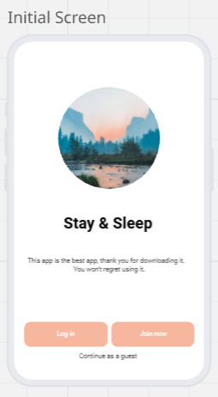
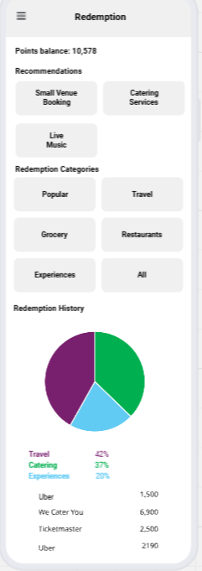
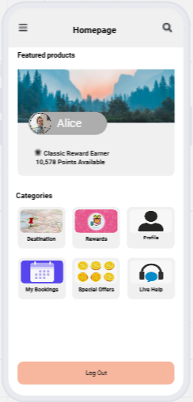
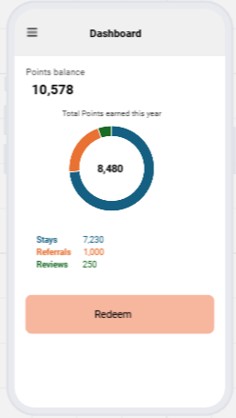
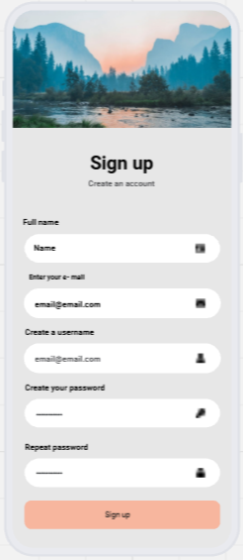
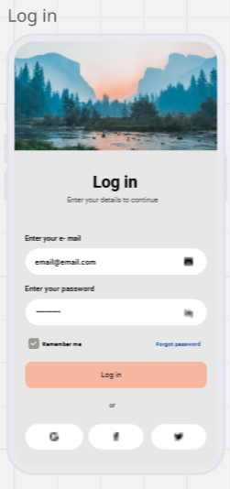
Notes:
Notes

Slide 14
Use Cases
Notes:
Notes

Slide 15
PRD
Use Case 1: Learning About Rewards & Referring a Friend
Title: Discover Rewards & Refer a Friend Persona: Alice Brooks — Small Business Owner & Traveler
Story: Alice gets an email about the new rewards program. She opens the app, learns how points work for bookings and referrals, and checks perks like ride credits, groceries, and event supplies. She shares her referral link with a colleague, who completes a booking. Alice gets a notification that her points are credited.
Outcome / Value:
Alice understands the program quickly
Referral drives new user acquisition
Higher engagement and repeat bookings
Acceptance Criteria:
Clear rewards info
Unique, trackable referral link
Accurate point crediting
Timely notification
Notes:
Notes

Slide 16
PRD
Use Case 2: Redeeming Points via Dashboard & Vendor Partnerships
Title: Check Dashboard & Redeem Rewards Persona: Alice Brooks
Story: Alice opens the Stay-N-Sleep Rewards Dashboard while planning a business workshop. She checks her points balance and redeems ride credits, grocery credits, and event supplies. Her selections are confirmed instantly, simplifying her planning and saving costs.
Outcome / Value:
Alice receives practical, business-relevant rewards
Rewards reduce hassle and improve travel experience
Reinforces loyalty to Stay-N-Sleep
Acceptance Criteria:
Dashboard clearly shows points balance
Redemption options align with user needs
Points deducted accurately
Notifications confirm reward use
Notes:
Notes

Slide 17
PRD
Use Case 3: Earned Rewards Notification After Stay
Title: Receive Notification of Earned Rewards Persona: Alice Brooks
Story: After a business stay, Alice receives a notification showing points earned and suggested rewards. She logs in, checks her balance, and plans which perks to use next.
Outcome / Value:
Alice feels recognized and rewarded
Encourages repeat bookings
Smooth link between stay and rewards usage
Acceptance Criteria:
Notification sent promptly
Points and rewards accurate
Dashboard updated immediately
Notes:
Notes

Slide 18
Success Metrics
Notes:
Notes

Slide 19
PRD
Success Metrics
1. Engagement Metrics
Program Enrollment Rate: 50% Enrollment of rewards by active users before Q2
Active Loyalty Users: 65% of enrolled users who earn or redeem points within a 3-month period.
Referral Shares: 15% of loyalty members who successfully refer at least one new user.
2. Redemption Metrics
Redemption Rate: 50% of earned points that members actually redeem for rewards
Popular Rewards: Most frequently redeemed rewards (ride credits, groceries, event supplies).
Notes:
Notes

Slide 20
PRD
3. Acquisition Metrics
Referral Conversion Rate: 15% of loyalty members who successfully refer at least one new user.
New Users via Referral: 10% increase to number of new users acquired through the program.
4. Business Impact Metrics
Repeat Booking Rate: % of loyalty members making multiple bookings. Average Booking Value (ABV): Compare ABV for loyalty members vs non-members.
Customer Satisfaction / NPS: Post-redemption feedback or survey.
5. Operational Metrics
Points Accuracy: % of points credited correctly after bookings or referrals.
Notification Timeliness: % of notifications sent successfully after points earned/redeemed.
Notes:
Notes

Slide 21
Launch Strategy
Notes:
Notes

Slide 22
Stay Pro Rewards Roadmap
Q1
Q2
Q3
Q4
Q1
Q2
Higher rebooking Rates
Rewards Structure and UX Designs
Uniquely tailored reward offers
Client Rewards Experience
Increased Customer Lifetime Value
User Notifications Enhancement
Leverage Key Partnerships
Vendor Partnerships Contracted
Survey and Support
Referrals ᛫ Bundle ᛫ Exposure
Tiered Loyalty Reward Program
(Silver, Gold, Platinum)
Lower Customer Acquisition Costs
Soft Launch including analytics
Full Roll-Out with Reward Notifications and Alerts

Slide 23
Engineering Sprints
OWNER | TASK | ROADMAP PHASE | MILESTONE
Back-End Engineering | Finalize Rewards Structure | 1 | Tracking & Infrastructure
UX Design | Design updated website to promote rewards program | 1 | Client Experience
UX Design | Finalize Rewards Page Designs | 1 | Client Experience
Compliance/Legal | Finalize Key Vendor Partnerships | 1 | Keystone Partnerships
Front End Engineering | Develop front-end for preferred review sorting for loyal users on website | 2 | Product Development
Documentation Writer | Prepare External Documentation of Rewards Program | 2 | Preferred Bookings
Customer Support | Train the customer team on how to support post Go-Live | 2 | Product and Client Support
Marketing | Develop and launch GTM for Loyalty Program (Dashboards, Badges, and First Look) | 3 | Preferred Bookings
All Devs | Soft Launch with Analytics | 3 | Client Experience
All Devs | Complete Notifications Enhancements | 4 | Product Development
All Devs | Address all feedback from Soft Launch | 4 | Product Development
All Devs | Stay Pro Rewards Full Roll-Out to all Clients | 4 | Client Experience

Slide 24
Go-To-Market Strategy
Notes:
Notes

Slide 25
GTM Strategy
GTM Strategy (1/4)
Launch Owner
Ritu Bansal – Senior Product Manager, Product Team,Stay & Sleep
Notes:
Notes

Slide 26
GTM Strategy
GTM Strategy (2/4)
Targeted Personas
Small Business Owner Demographics: 28–45 years old, owns or runs a small business, frequently travels for client meetings. Behaviors: Makes multiple bookings per month, values efficiency, cost savings, and convenience. Needs & Motivations: Wants loyalty rewards to reduce travel costs and streamline booking; motivated by points and discounts for frequent business travel. | Corporate Professional Demographics: 30–50 years old, works in corporate roles, manages team travel and budgets. Behaviors: Books travel for self and team, prefers premium options, focused on reliability and efficiency. Needs & Motivations: Motivated by program perks that benefit team travel, priority access, and corporate incentives. | Leisure Traveller Demographics: 22–40 years old, individual or family travelers, often books vacations or weekend trips. Behaviors: Seeks unique experiences, engages with promotional campaigns, enjoys recognition and rewards. Needs & Motivations: Motivated by points accumulation, tiered rewards, exclusive offers, and personalized experiences.
Notes:
Notes

Slide 27
GTM Strategy
GTM Strategy (3/4)
Monetization Strategy | Channels & Tactics: (Mix of HubSpot / Flywheel)
Increase Customer Lifetime Value (CLV) through repeat bookings and loyalty engagement. Drive new customer acquisition via referral rewards. Upsell premium rewards and partner offers to enhance engagement and revenue. Implement tiered reward levels (Silver, Gold, Platinum) to incentivize higher spending. | Booking Checkout Prompt during launch month In-App Notifications for existing users Website Banner Alerts Targeted Email Campaigns SMS Notifications for points, upgrades, and offers Social Media Campaigns showcasing program highlights Vendor Partnership Exposure for co-branded promotions
Estimated Spend | Total MVP Marketing Spend: $35,000
Allocate budget across high-conversion channels, prioritizing email, in-app, and website banners. | Email Campaigns: $10,000 Social Media Campaign(Inbound marketing) : $15,000 Website Banners: $5,000 Referrals: $5000
Notes:
Notes

Slide 28
GTM Strategy
GTM Strategy (4/4)
Campaign Effectiveness | Customer Adoption | Customer Support & Marketing Maintenance
Metrics:email open/click-through rates, notification click-through rates, referral acquisition, social engagement, Program enrollment rate, repeat booking rate, points redemption rate, Tools/Methods: CRM dashboards, analytics platforms, cohort analysis, A/B testing of campaigns. | Education & Support Plan: In-depth FAQ explaining tiers, benefits, and redemption process Onboarding emails with step-by-step instructions Live Chat for enrollment and reward queries Optional training/webinars for corporate accounts to maximize adoption | Product engineering grace period of 2 weeks post-launch to fix any issues Scale customer support based on volume and adoption trends Quarterly marketing campaigns to maintain engagement Continuous KPI monitoring to refine rewards, messaging, and promotional strategies
Proposed Customer Message
“Unlock more value every time you book! Join our loyalty program today to earn points, enjoy exclusive perks, and get rewarded for the experiences you love.”
Notes:
Notes

Slide 29
Thank you!
Questions?
Notes:
Notes

